Slide 1
Digit Recognition with Python
Team 10
Kritika Sinha, Akshay Gupta, Harshavardhan Reddy PBS, Yuntian Ma

Slide 2
Outline
Business Case
Proposed Solution
Basic Theory
Data Source and Transformation
Statistical Techniques explored
Output and Demo
Future Scope

Slide 3



Business Case and Proposed Solution
Current Situation
Proposed Solution
Desired Situation
Customer Dissatisfaction
Customer Satisfaction
Waiting Time
Delayed Transaction
Advanced
Analytics
24 x 7 Customer Support
Improve market reach
Lack of Resources
Check Clearance
Resource Optimization
Increase Market share
Customer Support
Reduce Infrastructure cost
Lack of resources and timely processing customer requests is the biggest issue that bank is facing
Develop an advanced analytical solution with which all bank related activities can be conducted remotely
Reduce work load on bank employees and help to reduce infrastructure cost. Optimize available resources

Slide 4
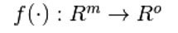
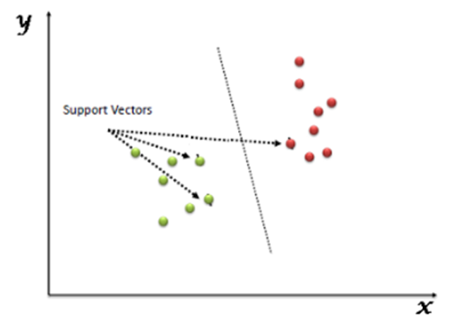
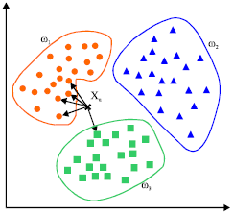
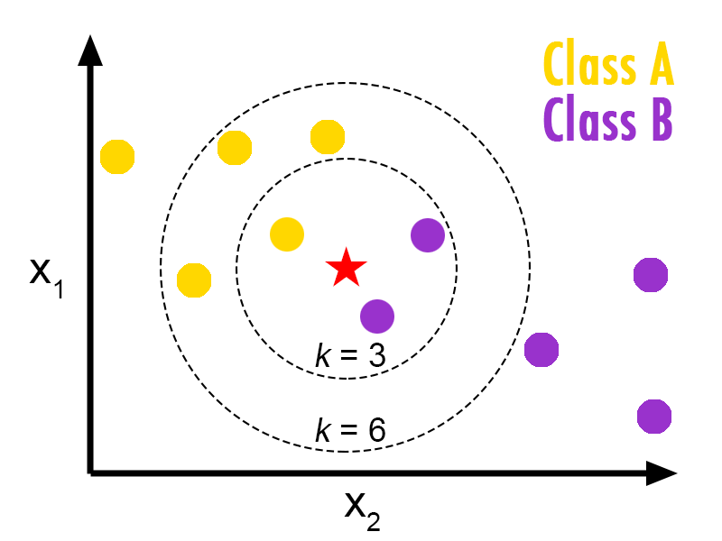
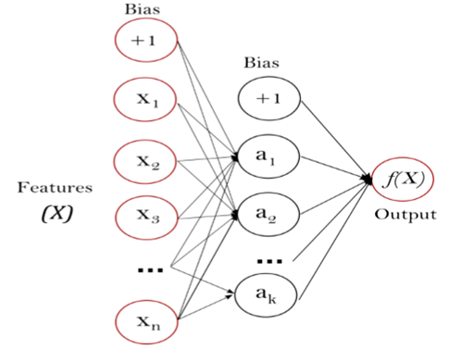
Basic Theory
Multi-layer Perceptron Neural Network (MLP)
Support Vector Machine (SVM)
K-Nearest Neighbor (KNN)

Slide 5
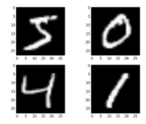
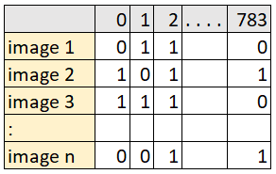
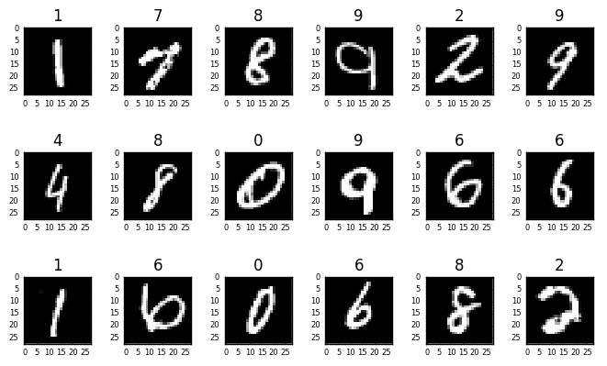
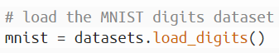
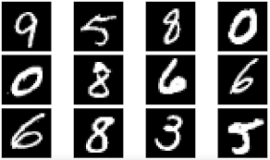
Data Transformation and Upload
Data Source
MNIST Dataset-Modified and constructed from a scanned document dataset available from National Institute of Standards and Technology(NIST)
Loading Images
Original Image
Flattened Image
Train/Test Samples
Images were loaded from libraries like tensorflow.tutorials and scikit-learn that host image samples of MNIST dataset
Each image of the loaded dataset had the following attributes:
Dimensions-28X28 Pixels
Color: Background-Black
Foreground-White
Each image was flattened to produce a vector of 784 pixels.
The vector is fed as input to the models
SVM/KNN Model:
Training sample-1212
Test sample-450
Neural Networks:
Training size-60000
Test sample-10000
Training
Test

Slide 6
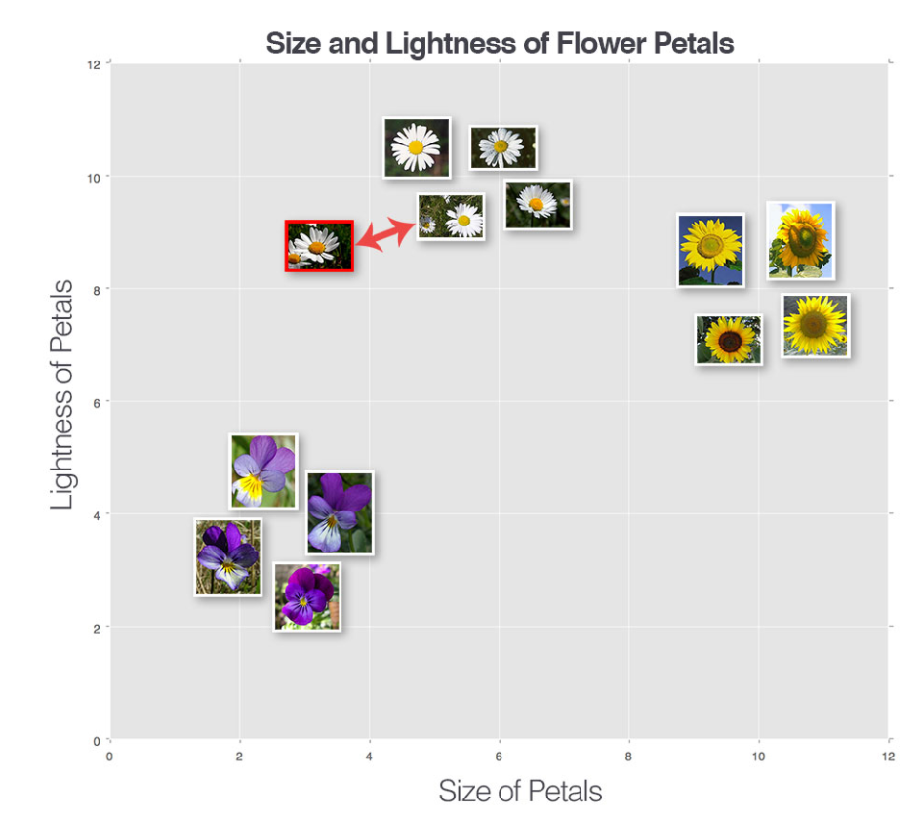
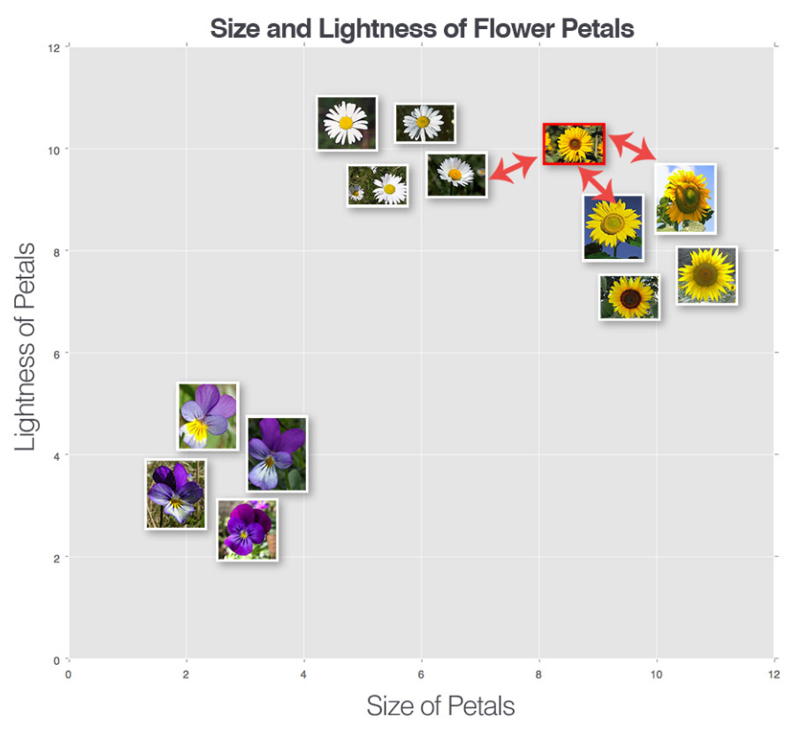
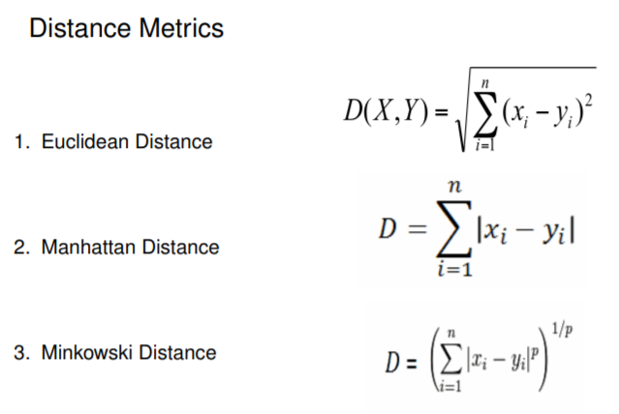
K-Nearest Neighbor Overview
ALGORITHM
K-Nearest Neighbor is a supervised classification technique which predicts the class of a new observation by picking the k closest data points to the new observation and then allocating the most common class among these observations to the new observation.
Compute distance
KNN when K=1
Select the value of K
KNN when K=3
Identify nearest neighbors
Select majority class

Slide 7
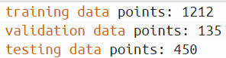
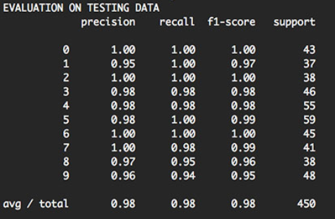
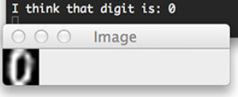
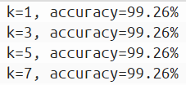
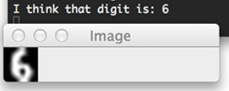
K-Nearest Neighbor Statistical Output
Building the Model
Model Evaluation
Model Prediction
In the final output we find that the digit “1” has the highest misclassification rate
Digit “0”, “2”, “6”, “7” have highest classification accuracy
Overall model accuracy is 98%

Slide 8
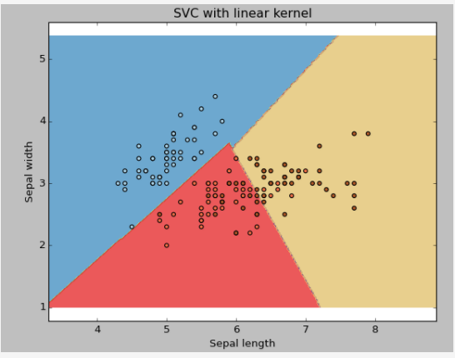
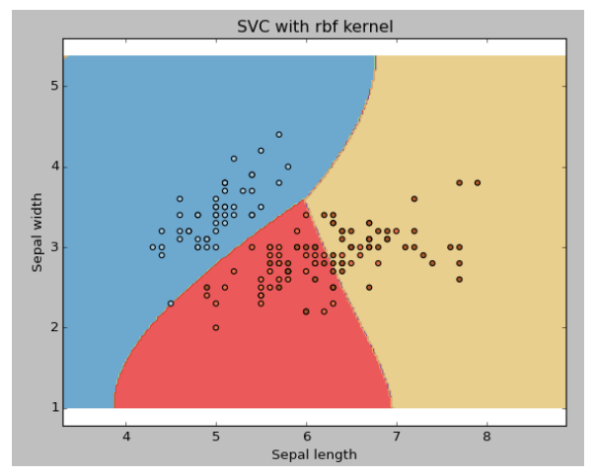
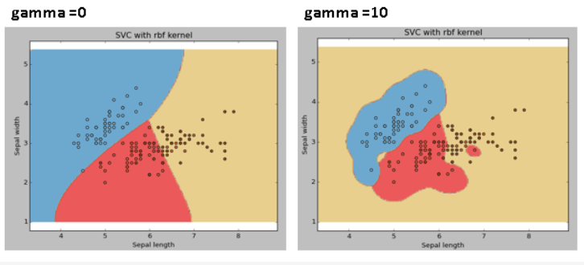
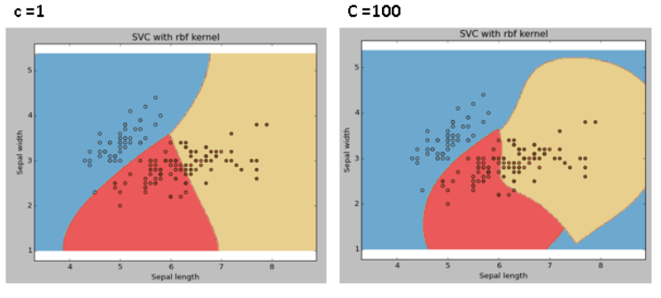
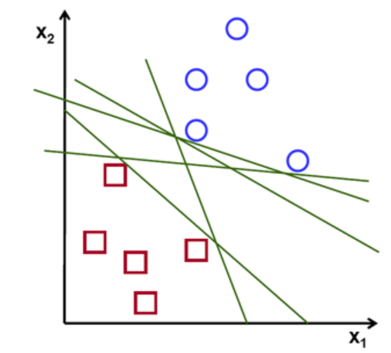
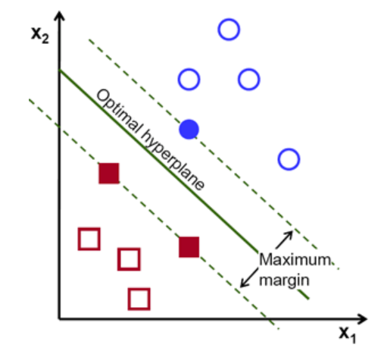
Support Vector Machine Overview
ALGORITHM
Support Vector Machine is a supervised classification technique that constructs a optimal hyperplane to perfectly separate the training observations according to their class labels and a new observation is classified on the basis of which side of the hyperplane it belongs.
Kernel
Gamma Value
Cost Value
linear
Non-linear
Creating optimal hyperplane

Slide 9
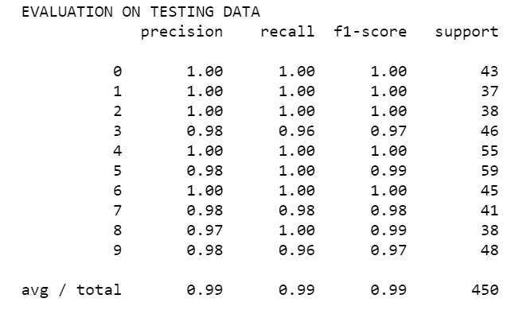
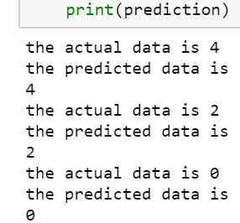
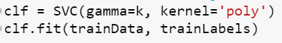
Support Vector Machine Statistical Output
Building the Model
Model Evaluation
Model Prediction
gamma | 0.1
C | 1.0
In the final output we find that the digit “8” has the lowest precision
Digit “0”, “1”, “2”, “4”, “6” have highest classification accuracy
Overall model accuracy is 99%

Slide 10
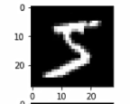
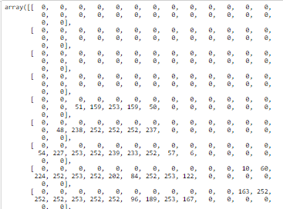
Neural Network
784 Pixel
28 X 28 Pixel
In neurons we have weighted sum of all the inputs and then we add biases then feed this to an activation function
Reshape Function
………
0
1
2
9
Activation Function
10 Neurons
Normalize output of all 10 neurons
Notes:
If weights and biases are correct then we will get a significant output corresponding to one neuron and that would be classified as the digit corresponding to that neuron
Final Output

Slide 11
Neural Network Cont..
Activation Function
Neurons
Batch of ‘n’ images
0
1
2
3
4
5
6
7
8
9
1 2 3 4 5 6… … … … … … … …784
9
4
6
2
5
3
0
1
…
Image 1
W₀
W₁
W₂
W₃
W₄
W₅
W₆
.
.
W₇₈₃
W₀
W₁
W₂
W₃
W₄
W₅
W₆
.
.
W₇₈₃
W₀
W₁
W₂
W₃
W₄
W₅
W₆
.
.
W₇₈₃
. . . . . . . . . . . . .
W₀
W₁
W₂
W₃
W₄
W₅
W₆
.
.
W₇₈₃
W₀
W₁
W₂
W₃
W₄
W₅
W₆
.
.
W₇₈₃
…
Image 2
. . . . . . . . . . . . .
…
Image 3
.
. . . . . . . . . . . . .
…
.
.
.
.
.
.
.
. . . . . . . . . . . . .
+
…
. . . . . . . . . . . . .
B₀ B₁ B₂ B₃ B₄ B₅ B₆ B₇ B₈ B₉
…
. . . . . . . . . . . . .
…
. . . . . . . . . . . . .
…
. . . . . . . . . . . . .
…
Image n
. . . . . . . . . . . . .
. . . . . . . . . . . .
.3
.6
.1
.7
.8
.9
.
.
.7
.5
.6
.1
.2
.3
.8
.
.
.3
.1
.4
.6
.8
.2
.6
.
.
.4
.3
.6
.1
.7
.8
.9
.
.
.7
.5
.6
.1
.2
.3
.8
.
.
.3
.1
.4
.6
.8
.2
.6
.
.
.4
.3
.6
.1
.7
.8
.9
.
.
.7
.5
.6
.1
.2
.3
.8
.
.
.3
.1
.4
.6
.8
.2
.6
.
.
.4
.3
.6
.1
.7
.8
.9
.
.
.7
To make this simple….
Image 1 0 0 0 34 0 56 ………....0 36 0
.
+
.2 .8 .4 .7 .2 .1 .4 .6 .4 .3
Image 2 0 0 0 23 0 0 …..……..0 89 0
2 X 784 matrix
784 x 10

Slide 12
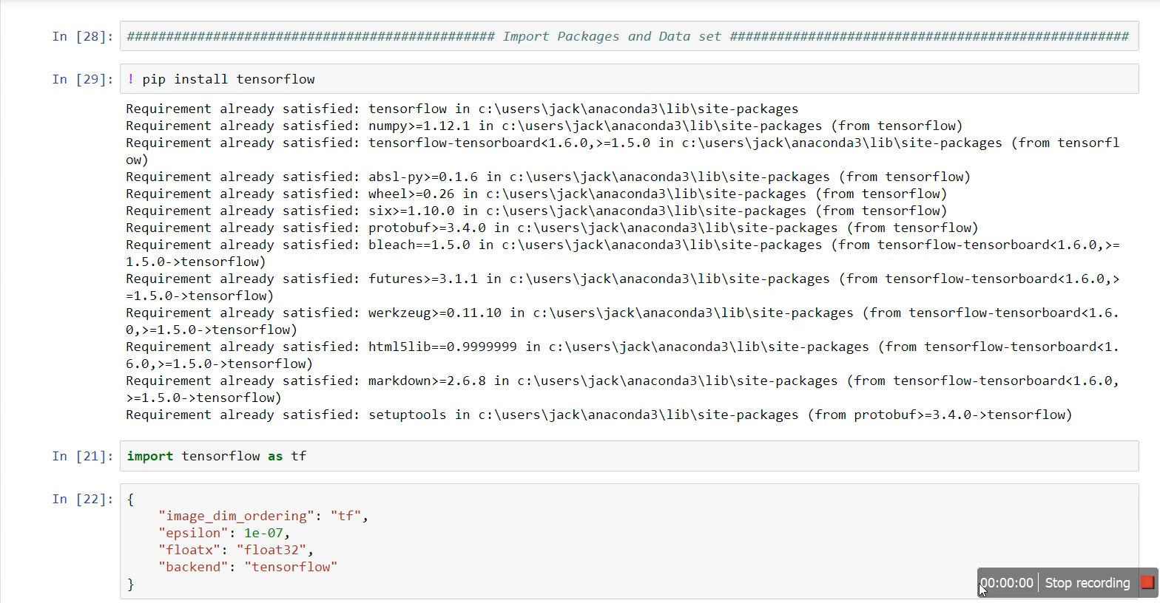
Neural Network Cont…

Slide 13
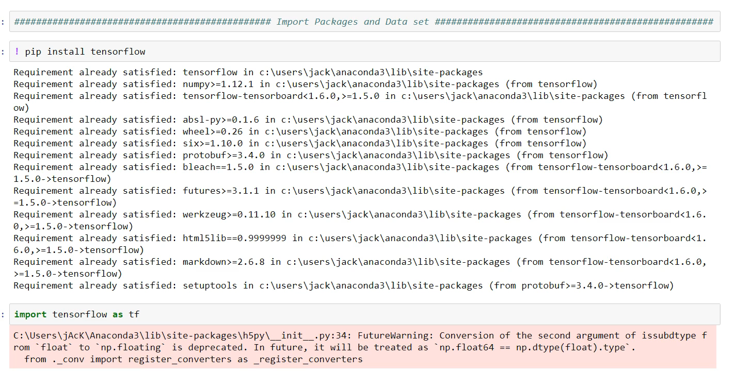
Neural Network Cont…

Slide 14
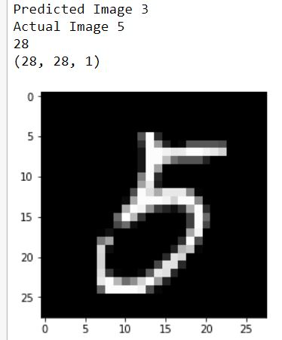
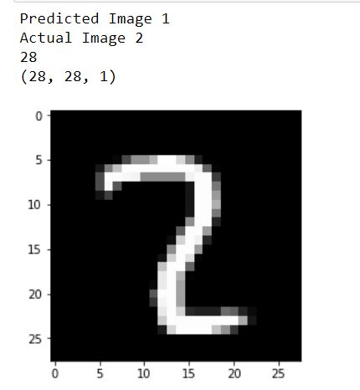
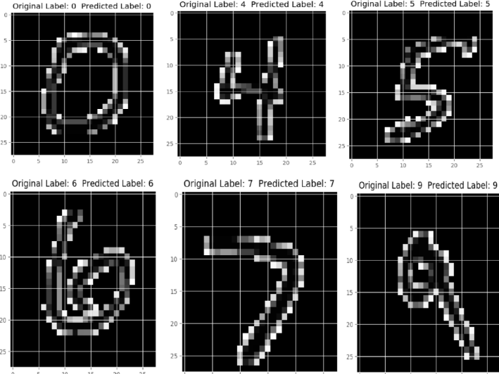
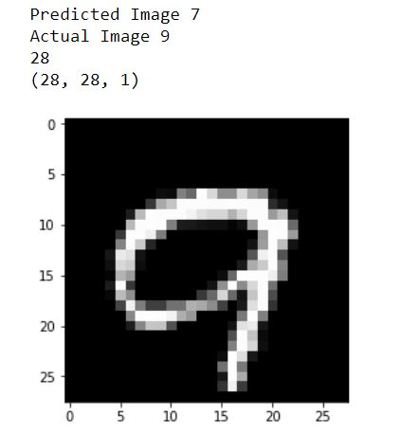
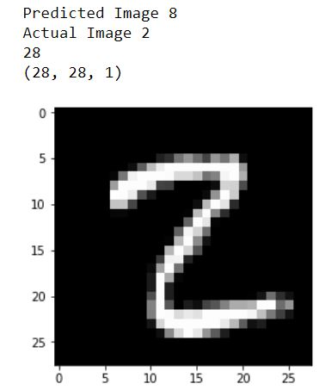
Output and Demo

Slide 15
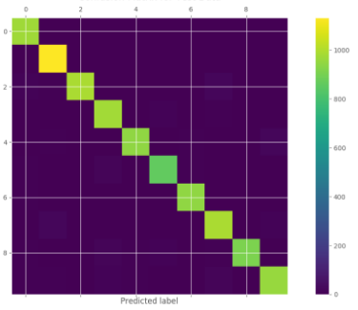
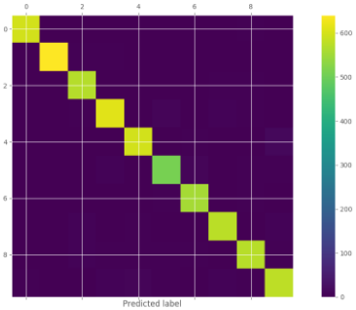
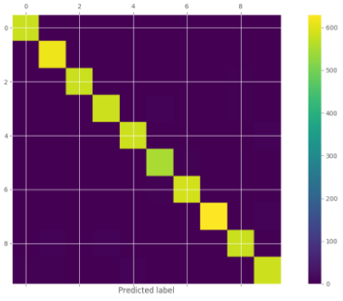
Confusion Matrix
Support Vector Machine (SVM)
K-Nearest Neighbour (KNN)
Multi-layer Perceptron Neural Network (MLP)

Slide 16
Future Scope
Detect custom hand written digits
Recognize signatures
Recognize hand-written characters
Recognize script written in various languages l

Slide 17
Q & A

